Slide 1
Chapter 05
Object Oriented Programming (SE 6022)
Generics

Slide 2
Objectives
After studying this chapter, students should be able to learn about:
Generic Classes
Generic Methods
Generic Interfaces

Slide 3
Introduction
Generic type represents classes, interfaces and methods in a type safe manner.
Generic types can act on any type of data.
All Generic types are subclasses of Object class, it acts on Objects only.
Generic types act on advanced data type only.
It is not possible to create an object to Generic type itself.
Using generic types, we can avoid casting in many cases.

Slide 4
Generic Class
When we create a class with an instance variable to store an Integer object, it can be used to store Integer type data only. We cannot use that instance variable to store a Float class object or a String type Object.
To store different types of data into a class, we have to write the same class again and again by changing the data type of the variables.
This can be avoided using a generic class.
A generic class represents a class that is type-safe. This means a generic class can act upon any data type.
Generic classes and generic interfaces are also called ‘parameterized types’ because they use a parameter that determines which data type they should work upon.

Slide 5
Generic Class - Example
//Example for Generic Class
class MyClass<T>
{ T obj;
MyClass (T obj)
{
this.obj = obj;
}
T getObj ()
{
return obj;
}
}

Slide 6
class Gen1
{ public static void main(String args[])
{
Integer i1 = new Integer (10);
MyClass<Integer> obj1 = new MyClass<Integer>(i1);
System.out.println ("U stored : " + obj1.getObj() );
Double d1 = new Double(30.66);
MyClass<Double> obj2 = new MyClass<Double>(d1);
System.out.println("U Stored: " + obj2.getObj() );
MyClass<String> obj3 = new MyClass<String>(“Sammie");
System.out.println ("U Stored : " + obj3.getObj() );
}
}
Output:
U stored : 10
U stored: 30.66
U stored: Kumar

Slide 7
Generic Method
We can make a method alone as generic method by writing the generic parameter before the method return type as:
<T> returntype methodname ()
{
//Method body;
}
Ex: <T> void display_data ()
{
//Method body;
}

Slide 8
Generic Method - Example
//Generic method example
class MyClass
{
<T>void display_data (T arr[])
{
for (int i=0;i<arr.length; i++)
System.out.print ("\t" + arr[i]);
System.out.println ();
}
}

Slide 9
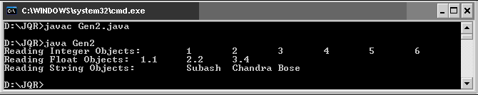
class Gen2
{
public static void main(String args[])
{ MyClass obj = new MyClass ( );
Integer a[] = {1,2,3,4,5,6};
System.out.print ("Reading Integer Objects: ");
obj.display_data (a);
Float b[] = {1.1f,2.2f,3.4f};
System.out.print ("Reading Float Objects: ");
obj.display_data (b);
String c[] = {"Subash","Chandra","Bose"};
System.out.print ("Reading String Objects: ");
obj.display_data (c);
}
}

Slide 10
Generic Interface
It is possible to develop an interface using generic type concept.
The general form of generic interface looks like:
interface interface_name <T>
{
//method that accepts any object
return_type method_name ( T object_name );
}
Here, T represents any data type which is used in the interface. We can write an implementation class for the above interface as:
class class_name <T> implements interface_name <T>
{
public return_type method_name ( T object_name )
{
//provide body of the method
}
}

Slide 11
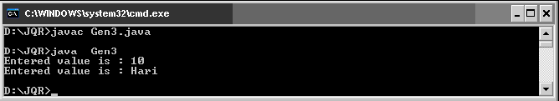
Generic Interface - Example
//A generic interface
interface inter<T>
{
void displayData (T obj);
}
class AnyClass<T> implements inter<T>
{ public void displayData (T t1)
{
System.out.println ("Entered value is : " + t1);
}
}
class Gen3
{ public static void main (String args[])
{ AnyClass<Integer> ob1 = new AnyClass<Integer>();
ob1.displayData (new Integer (10) );
AnyClass<String> ob2 = new AnyClass<String>();
ob2.displayData (new String ("Hari") );
}
}

Slide 12
Self- Review Questions
Write a generic method to count the number of elements in a collection that have a specific property (for example, odd integers, prime numbers, palindromes).
Write a generic method to exchange the positions of two different elements in an array.
Given the following classes:
  class Shape { /* ... */ }
  class Circle extends Shape { /* ... */ }
  class Rectangle extends Shape { /* ... */ }
  class Node<T> { /* ... */ }
Will the following code compile? If not, why?
  Node<Circle> nc = new Node<>();
  Node<Shape> ns = nc;

